Slide 1

Tuning Compression Parameters for performance.
Notes:
Hello, this presentation will discuss the efficacy of a system used to optimise pruning parameters with a focus on improving the effective latency of neural networks during inference.
We will begin by summarising our goals then we briefly demonstrate our system, followed by a discussion of our results based on experiments we performed to analyse the system.

Slide 2
Dissertation Focus
Using pre-existing pruning configurations, optimise them to improve latency while minimising the cost to accuracy.
Develop a system to automate this optimisation process.
Notes:
This dissertation was primarily motivated by the complexity of neural network pruning, finding the sweet spot for a neural network pruning configuration can require a large volume of trial and error.
We aim to reduce latency by repurposing a machine learning hyperparameter optimisation algorithm that allows us to test sets of parameters based on information gleaned from prior tests, so we can trade off the more expensive retraining work for some additional up front work analysing the data.

Slide 3
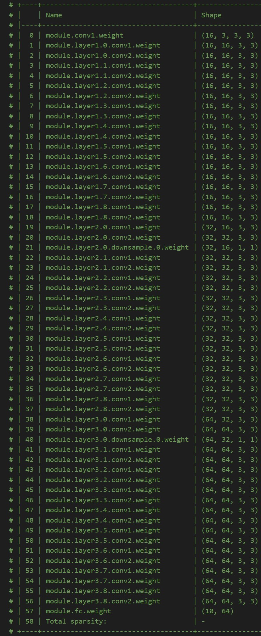
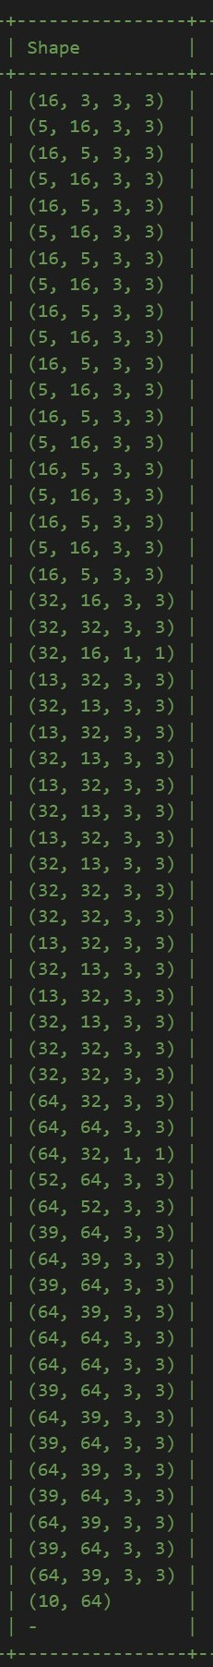
Input Shape
Pruned Shape
Notes:
In order to understand how to prune a network we need some insight into the shape of a network. We selected a Resnet56 network that was pretrained on the 10 class CIFAR 10 dataset.
Here we can see the Name column which shows us what each of the 56 layers is called. The Input shape column tells us the shape of the input matrix for each layer, this 4D vector represents the height, width, depth, and batch size (in other words the size of the image, the image channels and the number of images in a single batch). The Pruned Shape column shows an example of how this input shape might change after the pruning process is completed, note that not all layers are pruned <click>, and that the layers are pruned differently depending on where they are in the network.

Slide 4
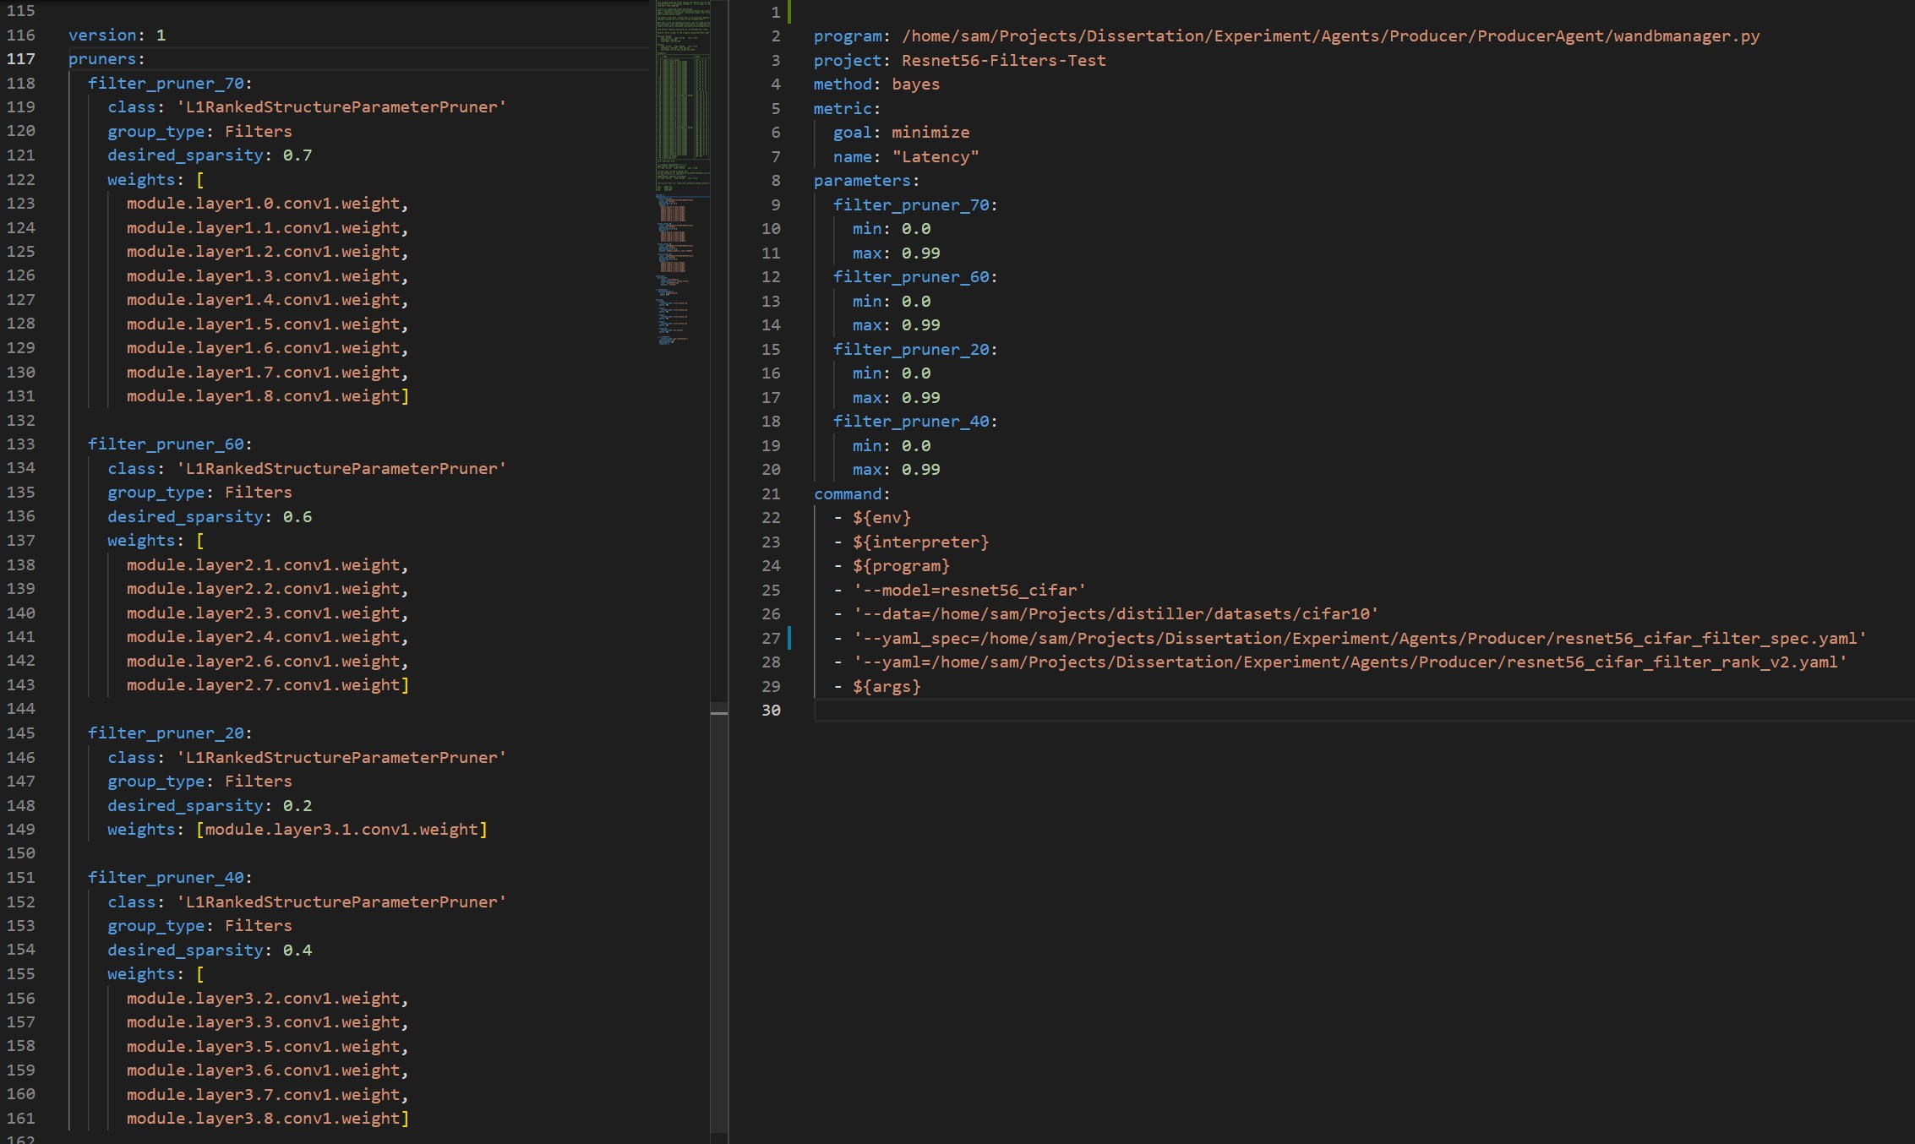
Notes:
Here we have some a pair of .yaml files used to define the pruning process for this implementation. On the left we have a pruning schedule used by distiller, and on the right a file to describe which values we wish to run the optimisation process on.
<click>
The right hand file refers to the different pruners in the left hand file, in this case we are searching over the desired_sparsity paramerter, <click> with the min and max values that we will search over defined here.
The same pattern is used for all the pruners. <click, click, click>

Slide 5
Notes:
Here we have two SSH tunnels into the machines being used in this demo, on the right we have the benchmarking machine, this has an intel Nerual Compute Stick attached on which we will be benchmarking each of the models once when they are pruned, and a second time at the end of the retraining process.
On the left we have one of the pruning and retraining machines, here we see it loading the baseline model and pruning it using the parameters provided by the optimisation system, next we can see the benchmarker receiving the pruned model and running.
Once benchmarking is complete the metrics are logged and retraining begins, in this demo we retrain for 70 epochs.
After the 70 epochs are complete the model is again passed to the benchmarking system, the same benchmark is run, with the same images, and the metrics are again logged.
This process will repeat until cancelled, data from previous runs is used to estimate which sets of parameters will be more likely to yield a good result based on the systems prior knowledge of the parameter settings with respect to the target metric.

Slide 6
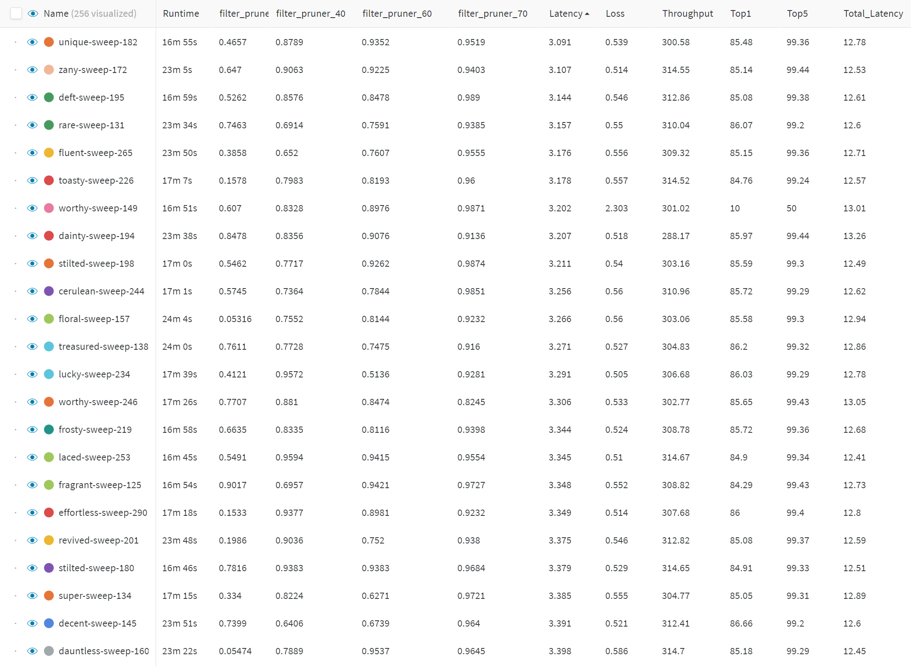
Notes:
We logged the parameters and performance metrics for all runs, here each row represents one run with a configuration for each of the pruners, here we see a small slice of the data from the second experiment sorted by Latency.

Slide 7
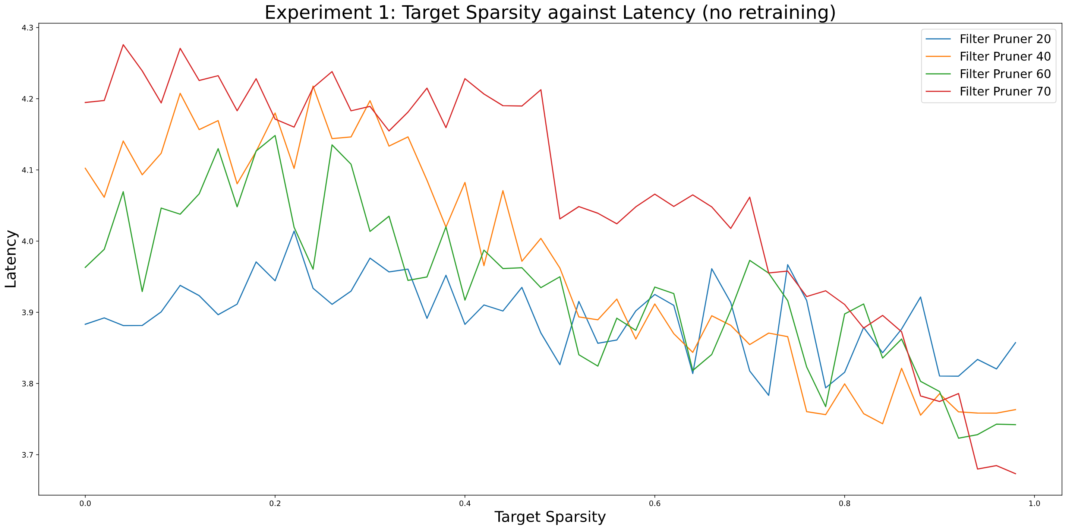
Notes:
In the first experiment we targeted latency with no retraining, we see how filter pruner 70 in red, which is pruning the first layer, has a strong negative correlation with Latency, this correlation confirms that the pruning parameters are associated with the actual change in latency, and gives an indication that pruning the first layer has the greatest effect on latency overall.

Slide 8
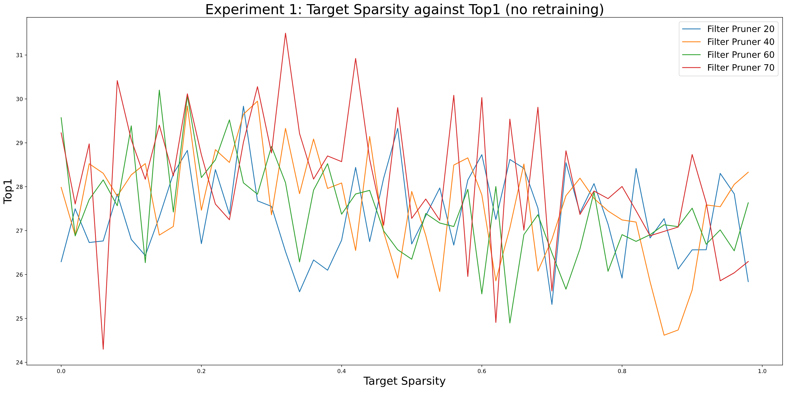
Notes:
Looking at the same Experiment 1 data, but Top1 against Pruner Sparsity we were unable to identify a clear pattern between any of them.
However this absence of a clear pattern is intriguing, intuitively we expect a higher degree of pruning to reducer Top1 accuracy further, however this is simply not the case. The slightest amount of pruning can have a devastating effect on the network, potentially reducing its Top1 to 10%, conversely much heavier pruning could just as easily result in a Top1 of 40%.
It may be worthwhile to investigate this in future work, particularly to identify indicators of success at retraining.
This prompted us to record an additional level of detail for each metric in the subsequent experiments, where we record all the metrics right after pruning but before retraining, by doing so we hoped to gain further insight into any patterns of improvement over the course of retraining.

Slide 9
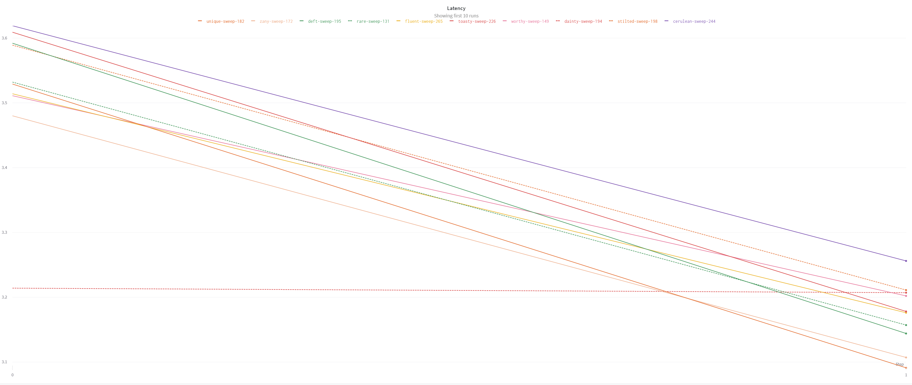
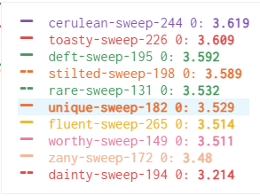
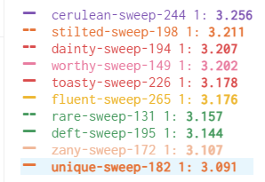
Lowest Latency 10 runs
Before Retraining
After Retraining
Notes:
One unexpected outcome from recording the metrics both before and after training was that the majority of networks dropped accuracy once training was finished.
When we take a closer look at this interim data from Experiment 2 we see this downward trend, this chart only shows the 10 lowest latency runs, however when we look at all runs in this manner we see some interesting trends, the latency of the network tends to (but not always) improve over the course of retraining. while this on its own is not enough to draw any conclusions it does raise the question of why the latency changes in some cases so dramatically during retraining, it is possible this is due to the model optimisation process used to load the model onto the neural compute stick but investigation is required.

Slide 10
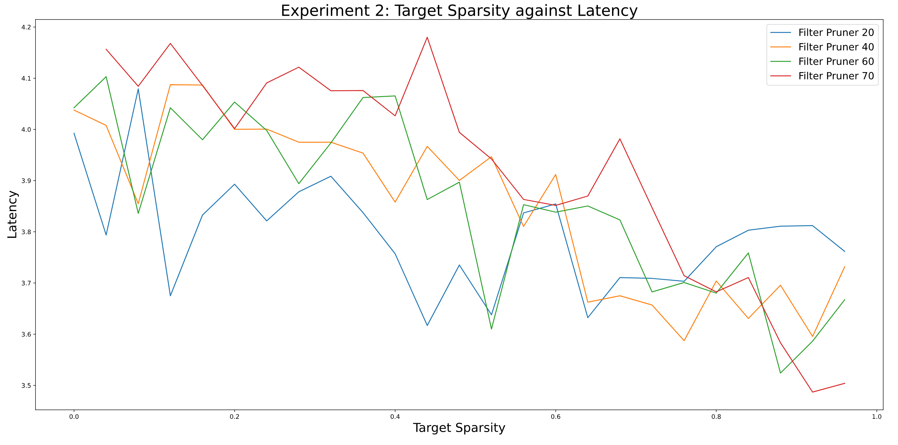
Notes:
Experiment 2 showed a similar story to Experiment 1, all pruners had a correlation with latency that was consistent with Experiment 1, however we were only able to perform 300 runs during this experiment, compared to 1800 in the first experiment. Mainly this is due to the high cost of retraining.

Slide 11
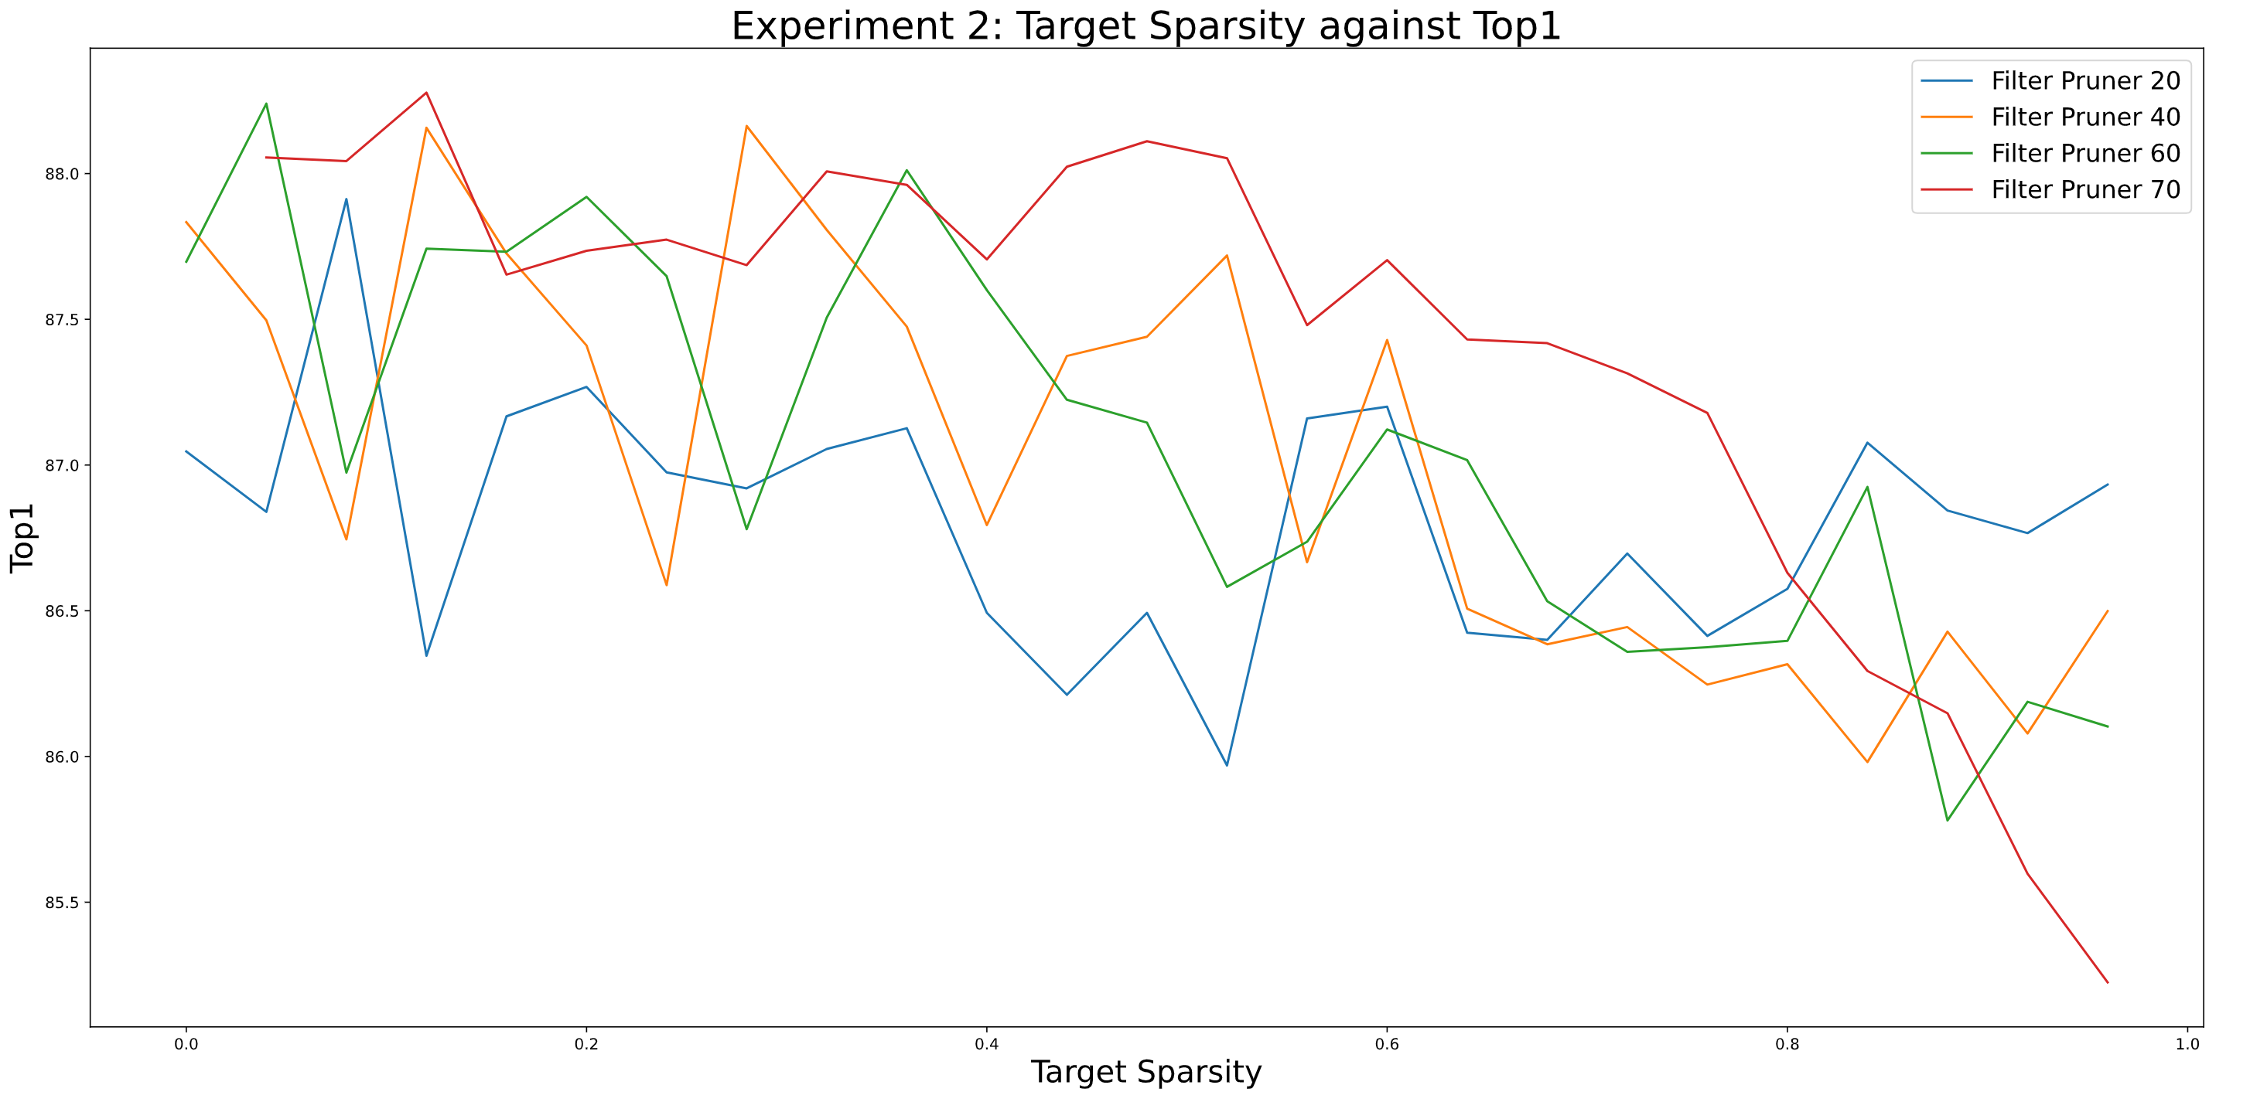
Notes:
Once retraining is complete we see a very similar relationship between Top1 and desired sparsity as we observed between Latency and desired sparsity, because we wish to maximise Top1 and minimise Latency this poses a problem, the next step in this work would be to find a way to reconcile these values, and find a sweet spot between them.

Slide 12
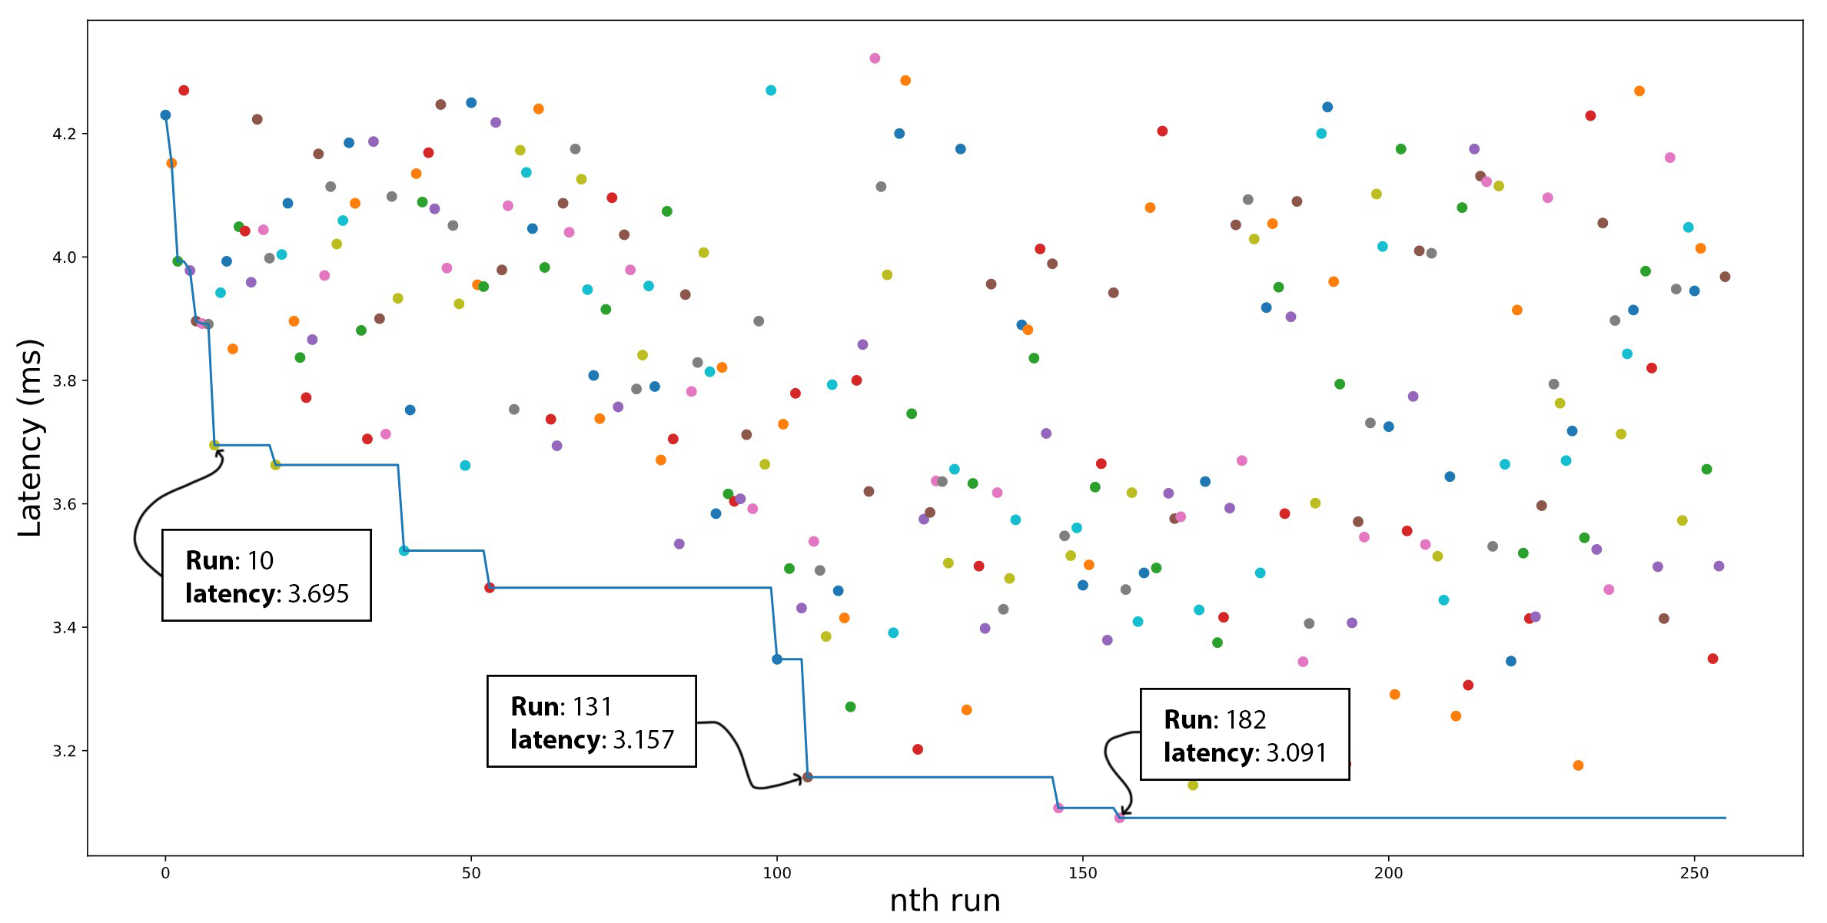
Experiment 2
Notes:
This chart offeres some insight into how well the system searches for good configurations, by plotting the latency against runs, we see solid improvements in latency for the first 100 runs and then it begins to converge.
In all 3 experiments we saw the same pattern, where the first 20 runs would offer the largest improvements and then the pace of improvement would slow substantially over 100.

Slide 13
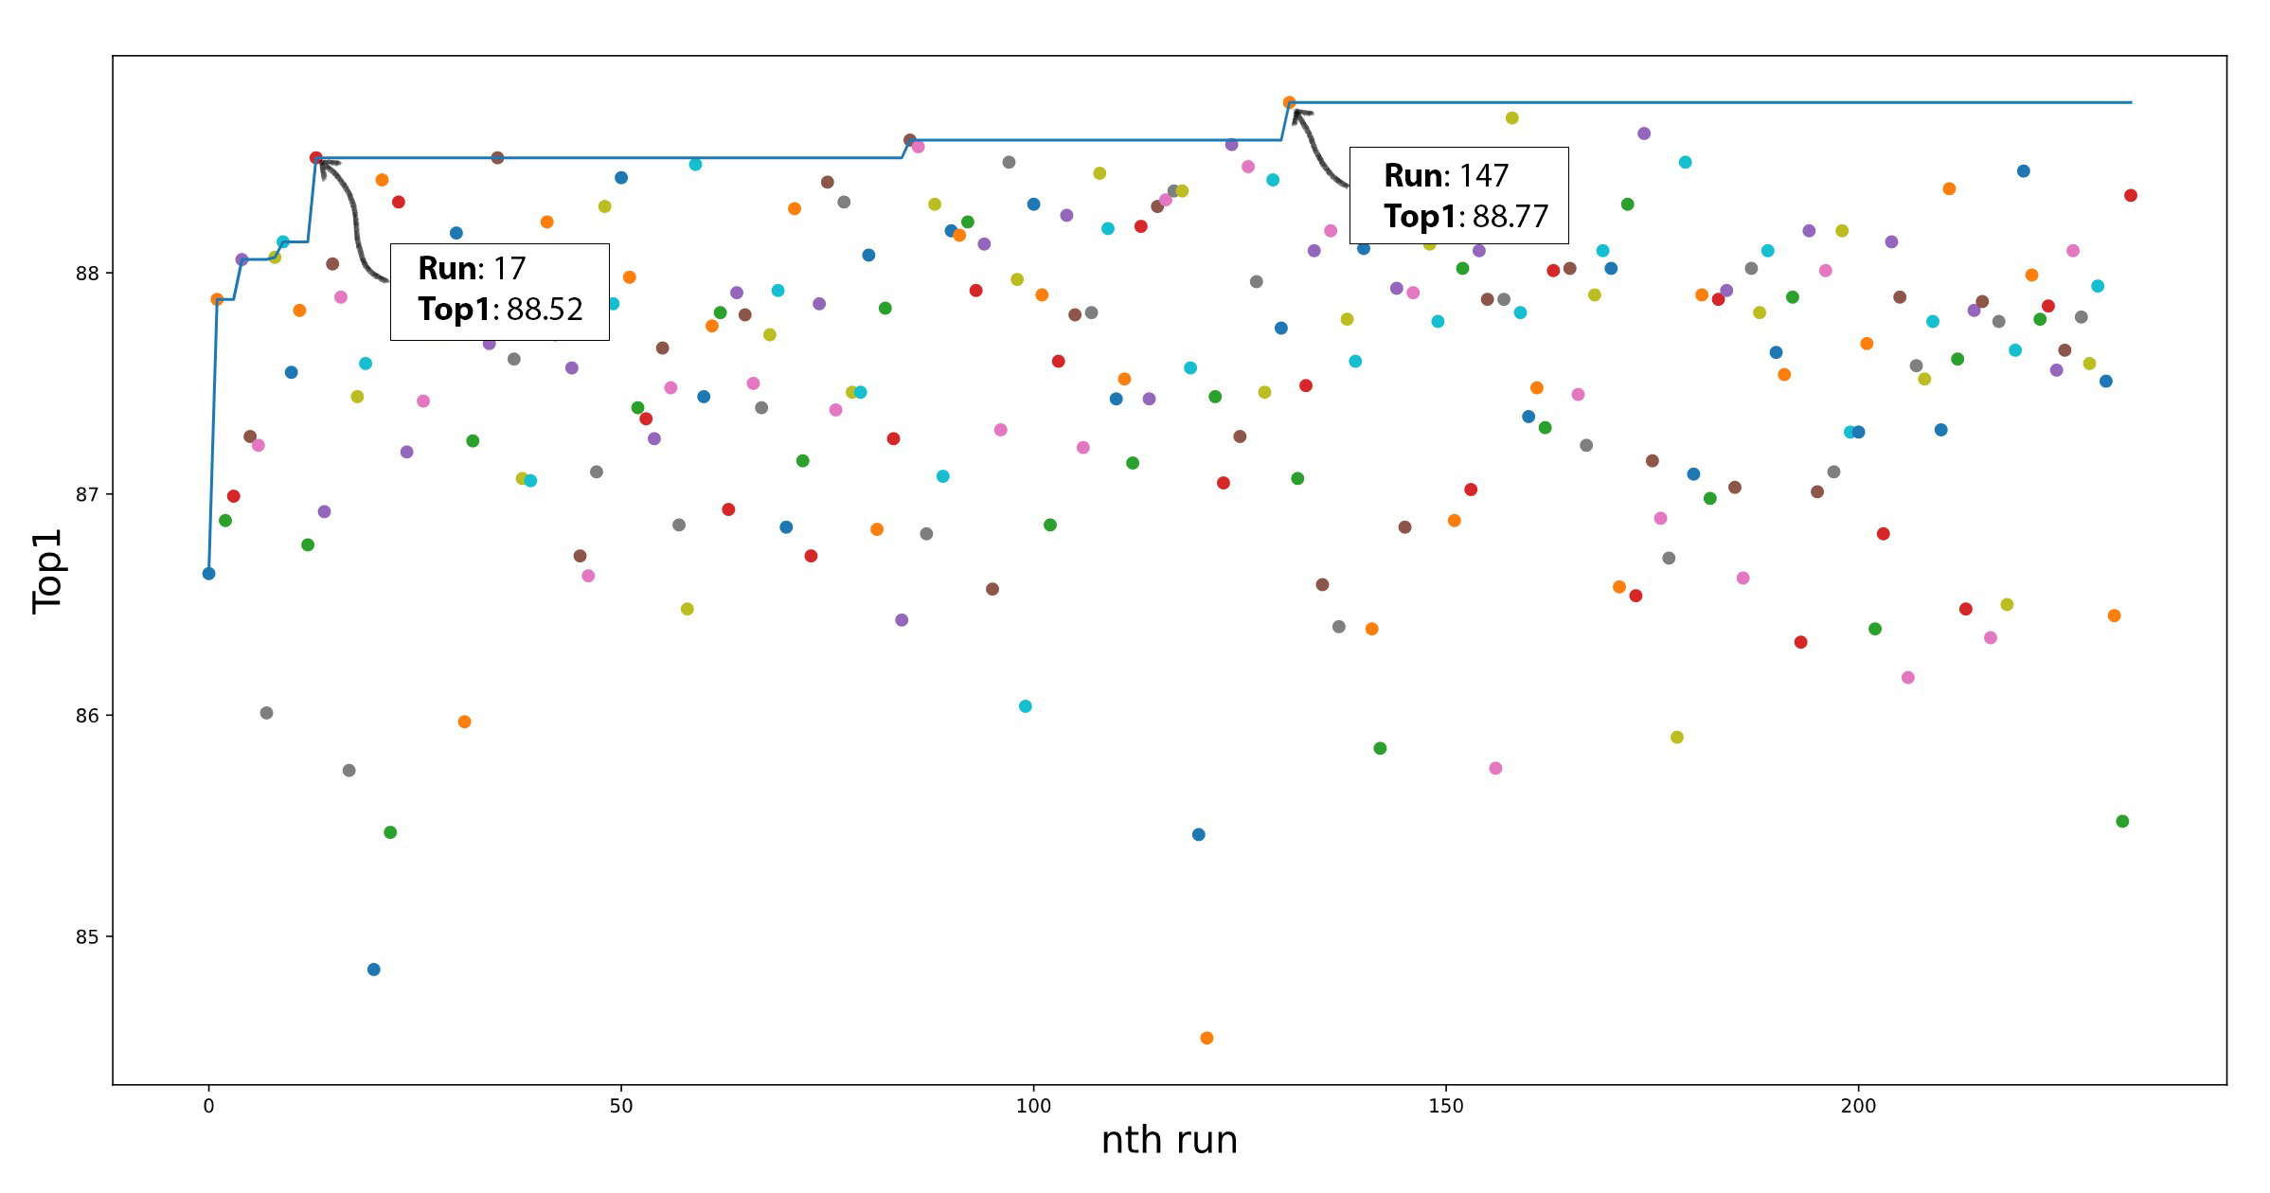
Experiment 3
Notes:
Design issues:
To fully accomplish what we set out to do we would need to account for accuracy in our parameter optimisation search.

Slide 14
Summary
The lowest Latency model we observed during the experiments was 29%, with a loss of 7.1% accuracy against the baseline unpruned network.
The highest Top1 we observed was 88.77% with a latency of 4.214ms, a marginal improvement in Latency over the baseline but at a cost of 3.81% Top1 accuracy.
Relaxing the training epoch constraints allowed our faster models to regain even more Top1 accuracy, but we were still unable to improve on our best Top1 score.
We did manage to improve on the preconfigured pruning schedule in terms of both Latency and Top1, achieving an 8.8% Latency improvement and a 0.36% accuracy improvement.
Where further loss of accuracy was acceptable we achieved an over 20% improvement in Latency at the cost of 2.24% Top1.
Notes:
This system proved effective at minimising latency, however it struggled to regain accuracy, this may have been in part due to the limited number of epochs available during training.
However even when relaxing this epoch limit we did not see any improvement in our best accuracy but the faster worse performing models did tend to recover better.
There is still much work to be done in this area, including improving the efficiency of retraining, and developing more intelligent strategies to prune networks.
Thank you for watching this presentation.

